Slide 1
Sentiment analysis
Based on network operator reviews
111903129 Vivek Bhand
111903130 Vrushabh Patil
111903131 Yadnyadeep Khadke
Guided By:
Dr. Y. V. Haribhakta

Slide 2
General overview of user’s sentiment towards the services provided on by the operator.
Identifying user’s satisfaction levels into classification level as
Satisfied
Unsatisfied
Neutral.
Analyze the reviews to collect suitable data for future decision for operator
Introduction to the project

Slide 3



Objectives
Objectives :
Classify the sentiments into Satisfied / Unsatisfied / Neutral
Classify the data region wise and year wise
Identifying the area for improvement and monitoring the variation of satisfiability over years
Building Sentiment Analyzer to classify the network related comments
2. Designing Model
3. Performance Measurement of the designed Model

Slide 4
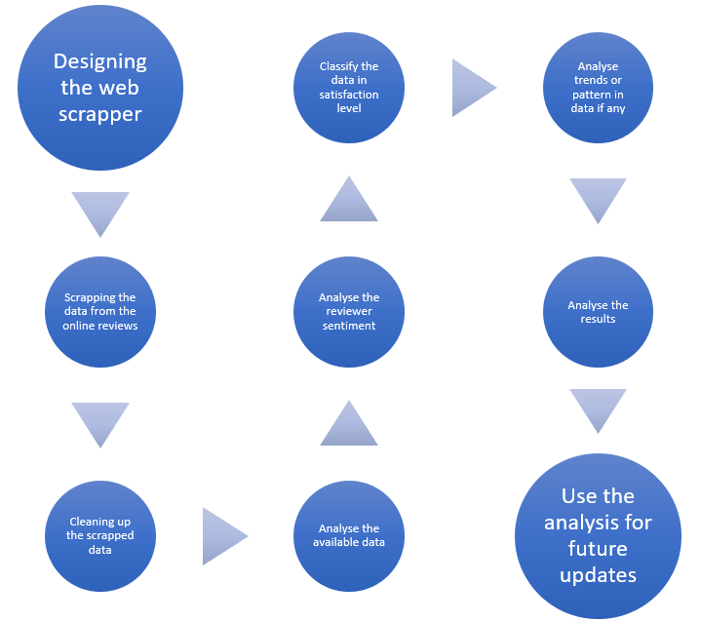
Design Model

Slide 5
Project Requirements:
A online platform for reviews
Web: https://www.mouthshut.com/mobile-operators/Reliance-Jio-reviews-925812061
Web scrapping tools
Scrappers Used :
Octoparse
Instant Data Scrapper
Attributes Scrapped:
user_id | location | reviews | Days ago (19-2-22) | Views | Stars | Comment

Slide 6
Data Preprocessing
Data Cleaning
Adding latitude & longitude to attributes using geopy library
Removing NaN values.
Removing extra white spaces, special characters.
Converting number to words in reviews
Converting date of reviews into number of days ago.
Normalization of data.
Removing unnecessary attributes.
Removing outliers

Slide 7
Exploratory Data Analysis
Correlation between attributes : Heatmap, Pairplots
Geospatial plot based on location of reviewer
Region-wise distribution of reviews

Slide 8
Hashing
Shingling : word level
Creation of corpus
Defining hash function
Min hashing
Local sensitive hashing
Similarity:
Jaccard Similarity
Cosine Similarity

Slide 9
Building Model
Lemmatize Comments
Vader Analyzer
Sentiment Polarity
X_train
Y_train
Logistic Regression
Model
Accuracy 87.76%

Slide 10
Analysis of Network performance
Identifying reviewer’s sentiment behind reviews
Observing Yearly variation in the sentiments of user.
Possible reasons
Analysed trends in sentiments in differents States
Possible reasons
Prediction on reviewer’s sentiment using model

